Slide 1
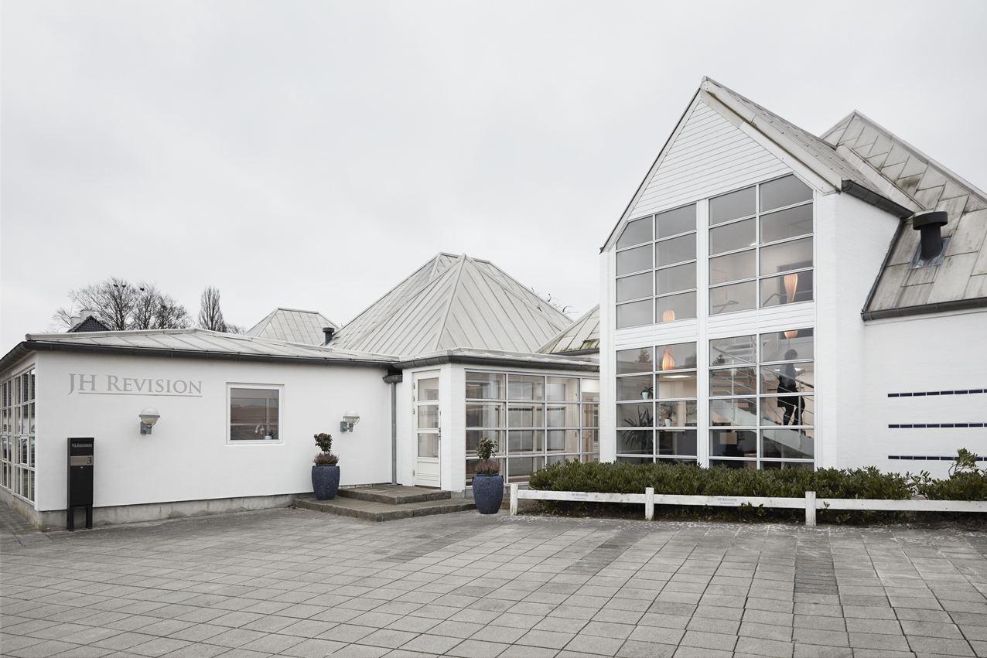
Short presentation
Clarkson Hyde Global conference 2021 in Malta

Slide 2
JH Revision in short
22 employees including 4 owners
Located in Copenhagen (Capital of Denmark)
Assist in audit, accounting and tax primarily to owner-managed companies and secondary to Danish subsidiaries of foreign owned-companies.
Part-owner of specialized tax and VAT advising company (15 employees)

Slide 3
History
JH Revision was established on 1 July 1991, when state-authorized public accountant Jan Hansen opened his own office in Taastrup, Copenhagen. At that time, the company consisted of 4 employees including Jan Hansen himself.
Since 1991, the company has had a steady growth with a more rapid growth the last five years (50%).
On 1 January 2020 a generational change was finalized and now the company is owned and run by 4 partners.
Pictures of our office and employees can be seen on jh-revison.dk (in Danish)

Slide 4
The Danish auditmarked 1/2
Around 300.000 business and a workingforce of 2.5 million people
More than 211,800 small and medium-sized private companies in Denmark, employing almost 764,000 people. In comparison, there are only 449 large companies with 250+ employees, which together employ 404,000 full-time employees.
All limited companies in Denmark who exceeds 2 of the following 3 is obliged to have the annual account audited:
Turnover of more than 1 mio Euro
Total assets of more than 0.5 mio Euro
12 or more employees

Slide 5
The Danish auditmarked 2/2
Expected new rules from 1/1 2022 to prevent fraud and tax evasion
All limited companies with a turnover between 0.55 and 1 mio. Euro is obliged to use a certified auditor (ordinary audit or 4410 statement) within 11 line of industries e.g transport, all sorts of dining (restaurants and fastfood and so on), pubs and nightclubs
All limited companies with total assets of more than 6.7 mio Euro is obliged to have their annual account audited

